Slide 1
Software Quality Recipes for Legacy .NET Applications
Matt Eland
@IntegerMan
https://www.Linkedin.com/in/MattEland/
Slides and code available at: https://GitHub.com/IntegerMan/SoftwareQualityTalk/

Slide 2
About Me
.NET / TypeScript / Angular Developer turned Manager / Mentor
Programming
For fun since 1987
.NET since 2001 (Beta 2)
Professionally since 2006
Addicted to Reading and Refactoring

Slide 3
My Background
Currently:
Software Engineering Manager at MoveHQ (1 year)
Previously:
Senior Software Engineer at TeamDynamix (9 years)
Software Developer at Exceptional Innovation (3 years)
Software Engineer at Verizon Business (6 months)

Slide 4
About This Talk
Intended to introduce variety of tools and ideas to give you options when working with legacy code
Structure:
Quick Primer on Unit Testing
Highlighted .NET libraries that aid in unit testing
Other techniques for improving software quality
Quick Primer on Quality Analysis

Slide 5
This Talk Is NOT
Focused on any one particular .NET project type (ASP .NET, XAML, etc)
Focused extensively on any one library or tool
Code-Intensive
Solely about unit testing
Intended to be prescriptive of one library / tool over another

Slide 6
Example Codebase: Resume Scoring Algorithm
Resume Information
System
Under Test
Resume Score

Slide 7
Example Codebase Overview
Written by “Interns”
(or me playing devil’s advocate)
Effectively a single long method
High degree of coupling
Uses EntityFramework to check keywords by value
Needs urgent refactoring

Slide 8
Current Testing Problems
Depends on a Database Connection
Undocumented Business Requirements
Too many Unique Paths through the Code (Cyclomatic Complexity)

Slide 9
A Primer on Software Testing

Slide 10
Types of Tests
Integration Tests
Manual
Unit / Component Tests
UI Automation
Exploratory

Slide 11
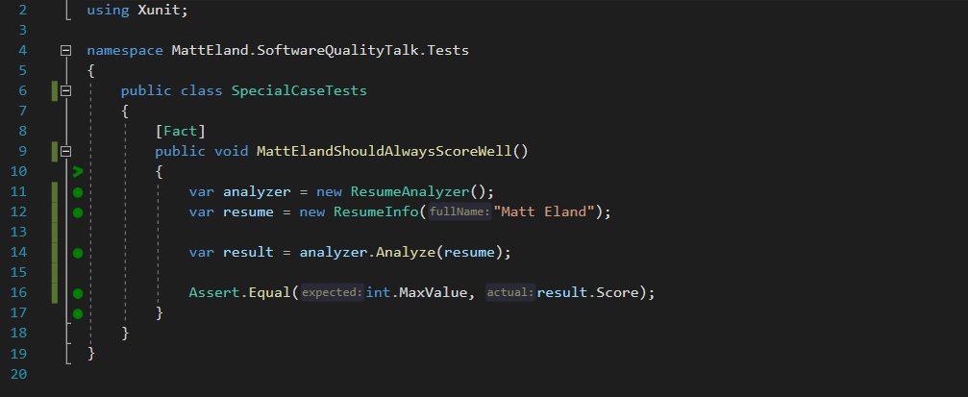
What is a Unit Test?

Slide 12
What is a Unit Test? – Detected by Attribute

Slide 13
What is a Unit Test? – Exercises System Under Test

Slide 14
What is a Unit Test? – Contains Assertions

Slide 15
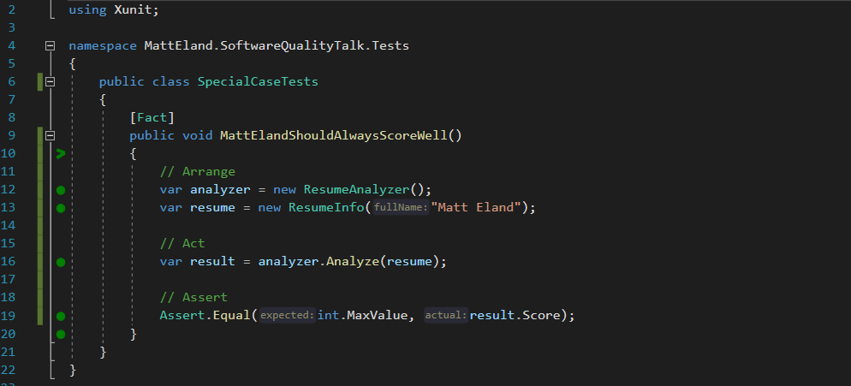
What is a Unit Test? – Arrange / Act / Assert

Slide 16
Test Driven Development (TDD)
Green
Clean up System Under Test
Red
Write a failing test
Make the test pass
Refactor

Slide 17
Unit Testing Frameworks
MSTest
Built into Visual Studio
TestMethod
NUnit
My preference when working with .NET Framework
Test / TestCase
XUnit
My preference when working with .NET Core
Fact / Theory
See https://raygun.com/blog/unit-testing-frameworks-c/ for detailed analysis of different frameworks

Slide 18
Parameterized Unit Tests

Slide 19
“Untestable” Code
Too many dependencies
Too large / too tightly coupled
Relies on external systems
Database
Web Service
File System
DateTime.Now
Random number generation

Slide 20
Making “Untestable” Code More Testable
Refactor unwieldy code
Aim for classes / methods that follow the Single Responsibility Principle
Extract small interfaces for dependencies
Replace interfaces at time of test with mock objects
May be controversial – some people advocate not modifying code for testing purposes
Try to isolate the aspects of your system that integrate with external resources

Slide 21
Sample Mock Object

Slide 22
Testing Libraries

Slide 23
Shouldly / FluentAsserts

Slide 24
Behavior Driven Development with SpecFlow

Slide 25
Scientist .NET

Slide 26
SnapShotter / ApprovalTests / Snapper

Slide 27
Moq to Create Mock Objects

Slide 28
Moq to Verify Behavior

Slide 29
AutoFixture

Slide 30
Bogus

Slide 31
SharpFuzz

Slide 32
EntityFramework

Slide 33
Other Recipes

Slide 34
User Interface Testing
Selinium
Katalon Recorder

Slide 35
Code Reviews

Slide 36
Code Analysis

Slide 37
Postman Collections For API Testing

Slide 38
Test Plans

Slide 39
Testing & CI/CD Pipelines

Slide 40
JetBrains Annotations / Code Contracts

Slide 41
Functional Programming

Slide 42
NCrunch

Slide 43
Defect Analysis

Slide 44
Tabulating Data

Slide 45
Defects by Type

Slide 46
New Defects by Root Cause

Slide 47
Defects by Area

Slide 48
Conclusion
Slides and code available at: https://GitHub.com/IntegerMan/SoftwareQualityTalk/

Slide 49
Key Takeaways
Slides and code available at: https://GitHub.com/IntegerMan/SoftwareQualityTalk/

Slide 50
Book Recommendations
Working Effectively with Legacy Code
XUnit Test Patterns
Measuring the Software Process
Developer Testing
Slides and code available at: https://GitHub.com/IntegerMan/SoftwareQualityTalk/

Slide 51
Questions? Other Quality Recipes?
Slides and code available at: https://GitHub.com/IntegerMan/SoftwareQualityTalk/

